Slide 1
R and Rattle Cheat Sheet
Michael Surdek
Southern New Hampshire University
DAT 640: Predictive Analytics
Professor Tom Woolman
January 9, 2022

Slide 2
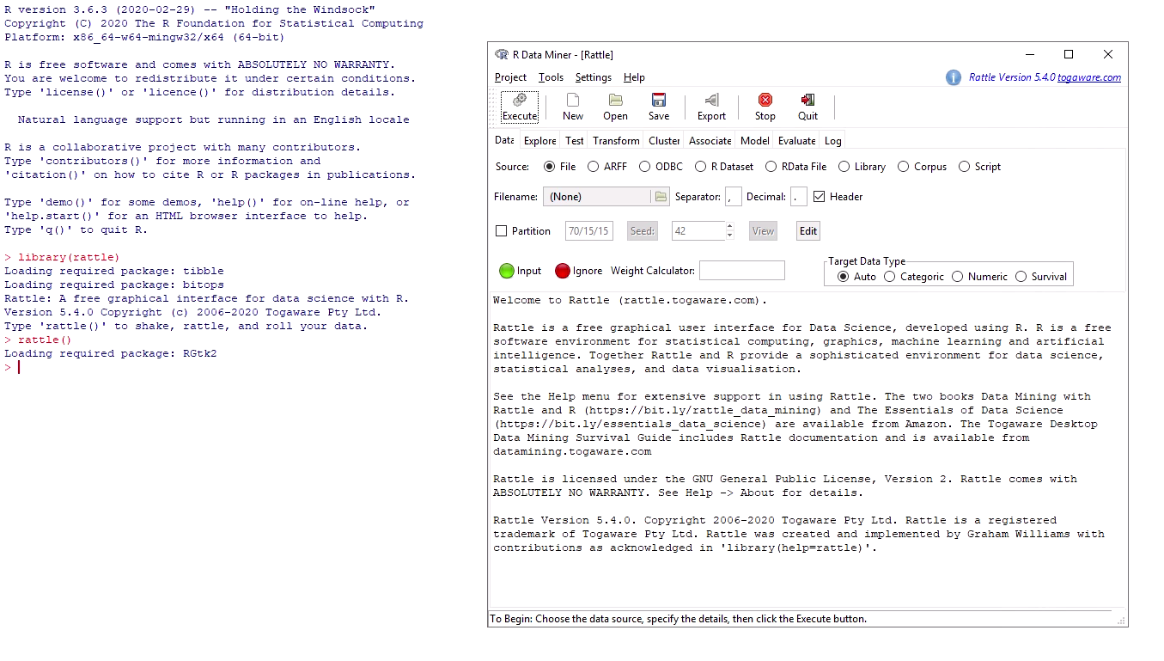
Starting and quitting R and Rattle
In the VDI, open R x64 3.6.3 application
Load the rattle package with library(rattle)
Launch the rattle GUI with rattle()
Quit R and Rattle with the “Quit” button or by typing q()

Slide 3

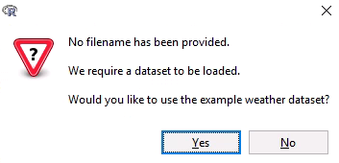
Loading a data set
Default weather dataset
  Simply click execute and rattle will ask if you wish to load the example weather data
External data source
  Type the file path next to filename or click on the folder button to browse your computer

Slide 4
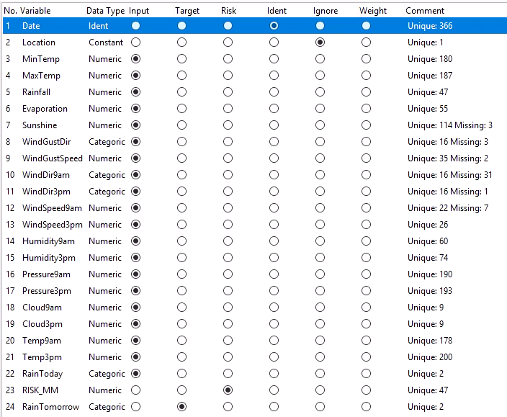
Building a model
Partition data to training/testing/validation sets
Select input/target/ident/etc types for each variable

Slide 5
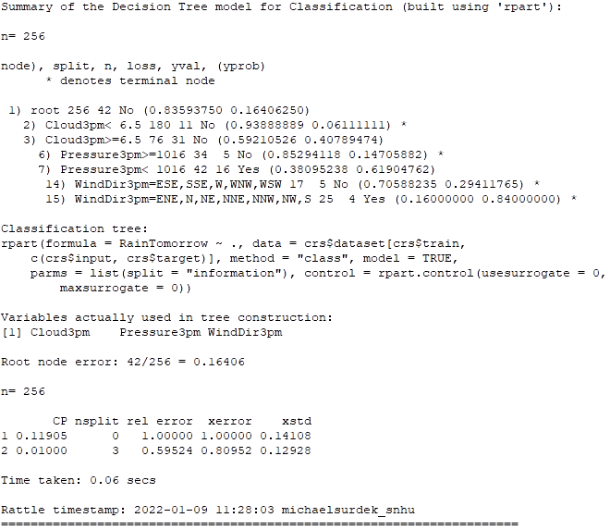
Building a model (cont)
On model tab, choose desired technique & parameters
Click execute to build model and view output

Slide 6
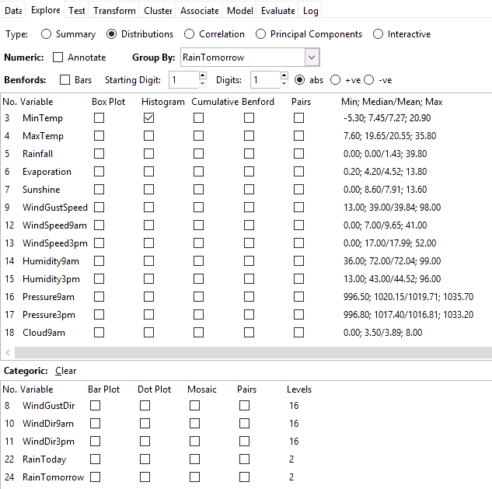
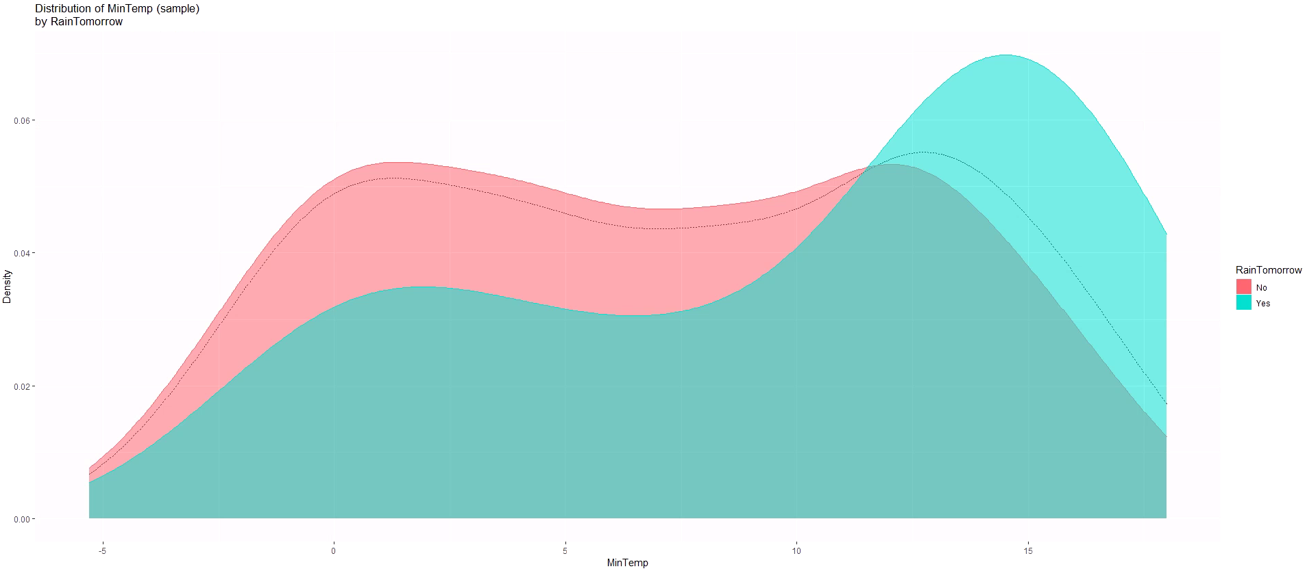
Understanding data
On explore tab, you can view summaries and descriptions the data, distributions of the variables, or correlation and principal component analysis information

Slide 7

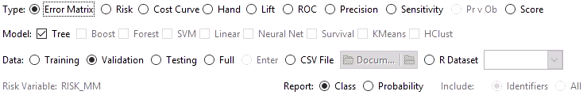
Evaluating a model
To better understand your model, you can view the drawing and rules of a decision tree from the model tab
To evaluate the model statistically, the evaluate tab offers techniques such as error matrix, sensitivity analysis, and others

Slide 8
Interacting with Rattle
Rattle’s nine tabs are aligned with the CRISP-DM process
Throughout the life-cycle of a data mining project, Rattle can serve to help understand the data, build and evaluate a model, analyze the data through clustering or association, and even provide the R code that accomplishes all of these things

Slide 9
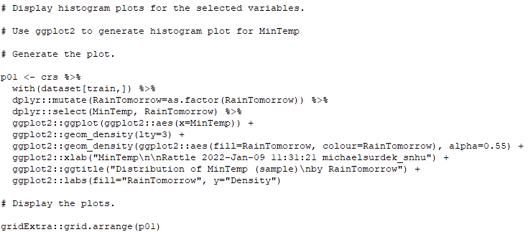
Interacting with R
A data practicioner will often go back and forth between the Rattle GUI and the associated R code that is provided in the log tab
For example, here is the code that Rattle generated to create the MinTemp histogram
This feature is helpful because the code can be refined and customized, as well as used directly in the deployment phase

Slide 10
Commands to know (Mod 1)
Library()
Rattle()
Q()
Dim()
Head()/Tail()
Help()
Print()
Ls()
Ll()
Attach()/Detach()
C()
Load()
Sample()
Save()

Slide 11
Commands to know (Mod 2)
Cat()
Gsub()
Names()
Paste()
Seq()
Str()
Sprintf()
Data()
OdbcConnect()
Read.****()
Sample()
Set.seed()

